Slide 1

Bottom cover tooling modified

Slide 2
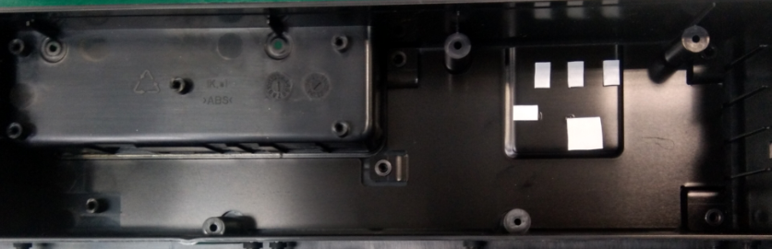
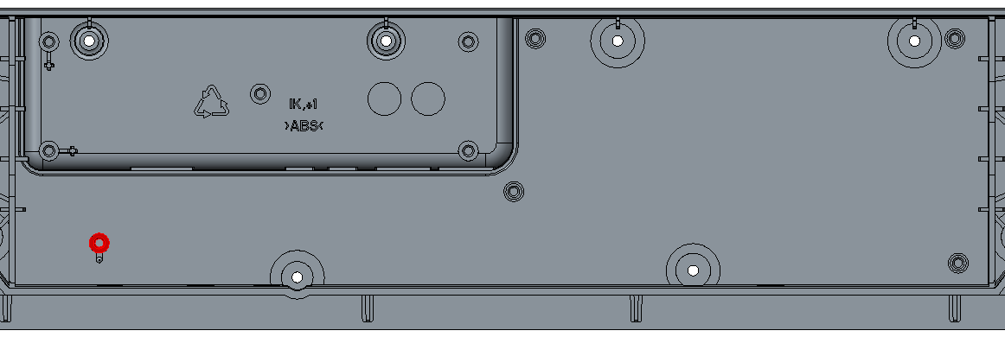
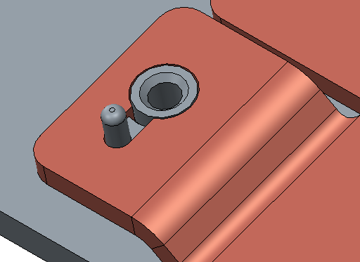
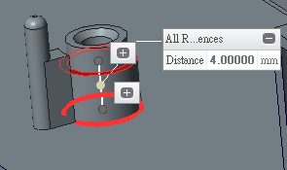
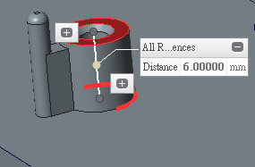
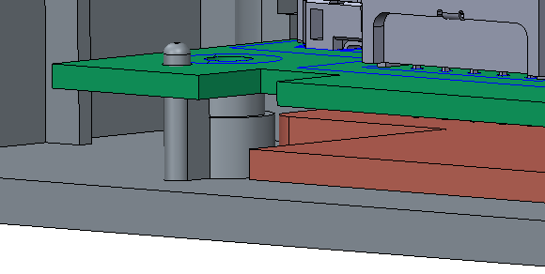
Heat spreader issue:
Heat spreader SoC bottom is too long but it isn't not drive screw to fix well in housing.
Recommendation：
1. Add more one screw hole on heat spreader but need to change screw-boss in the bottom cover.
Add screw hole on heat spreader
Need to be reduced by 2mm on screw hole
Heat spreader for DVT build
We can also assembly the SoC board with DVT heat spreader samples.

